Slide 1
IOT AND CLOUD COMPUTING LAB
By,
Asst. Prof. S.Asra
M.E(Computer science & Engineering)
B.E(Computer Science & Engineering)
Diploma(Computer Science & Engineering)

Slide 2
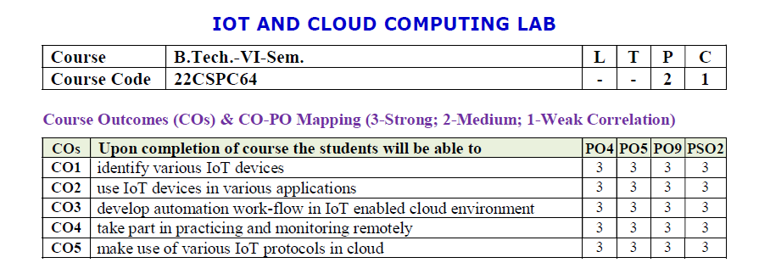

Slide 3
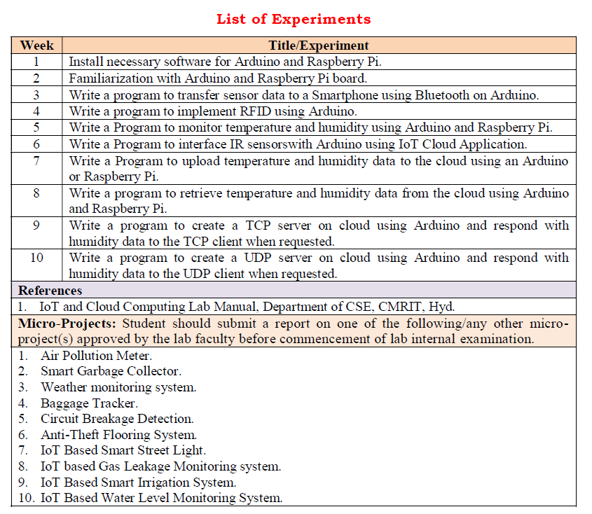

Slide 4
WEEK-9
01
AIM: Write a program to create TCP Server on cloud using Arduino and Respond with humidity data to TCP Client when requested.

Slide 5
An IoT device can be made to communicate with a cloud or server using TCP/IP protocol without any hassle of network programming and network administration. In this project, an IoT device will be designed that could transmit sensor data to ThingSpeak Platform using the TCP/IP protocol.
The IoT device designed in this project is built using Arduino UNO. The Arduino is just a microcontroller board and cannot connect to an internet network on its own. For internet connectivity, the Arduino UNO is interfaced with ESP8266 module.
Asst. Prof. S.Asra
CSE Department, CMRIT

Slide 6
The ESP8266 Wi-Fi Module is a self contained SOC with integrated TCP/IP protocol stack that can access to a Wi-Fi network. The ESP module allows the Arduino board to connect with a router and access internet network. The Arduino is programmed to communicate with the cloud platform.ThingSpeak over TCP/IP protocol. The Arduino can implement TCP/IP protocol by passing AT commands serially to the ESP8266 module.
Asst. Prof. S.Asra
CSE Department, CMRIT

Slide 7
The IoT device designed is a visitor counter as well as temperature and humidity monitor. For working as visitor counter, the IR sensors and Photodiodes are interfaced with the Arduino board. For working as temperature and humidity monitor, a DHT-11 sensor is interfaced with the Arduino board.
.
Asst. Prof. S.Asra
CSE Department, CMRIT

Slide 8
The Arduino reads data from the sensors and send it to the ThingSpeak platform. A 0.6 inch 128 X 64 OLED is also interfaced with the Arduino which receives serial data from the board on I2C protocol and display the current temperature and humidity readings. The user can monitor the number of occupants in the house, temperature and humidity values from anywhere by accessing the ThingSpeak platform.
Asst. Prof. S.Asra
CSE Department, CMRIT

Slide 9
The Arduino board controls all the functionalities of the IoT device like counting visitors, reading temperature and humidity values from DHT-11 sensor, displaying temperature and humidity data on OLED, implementing TCP/IP protocol, connecting with ThingSpeak platform and sending data to the cloud server.
For this, the Arduino code is written and compiled using Arduino IDE.
Asst. Prof. S.Asra
CSE Department, CMRIT

Slide 10
Software Required –
• ThingSpeak server
• Arduino IDE
The IoT device that communicates with the ThingSpeak Cloud is built on Arduino UNO. The DHT-11 Sensor, ESP8266 module and jumper wires are required.
Asst. Prof. S.Asra
CSE Department, CMRIT

Slide 11

Arduino: It is an Atmega 328 based controller board which has 14 GPIO pins, 6 PWM pins, 6 Analog inputs and on board UART, SPI and TWI interfaces. The Atmega 328 is the sitting MCU on the Arduino board. There are two GPIO pins (external interrupt pins INT0 and INT1) of Arduino board used to interface photodiodes, TX and RX pins (pins 3 and 2 respectively)are used interface ESP module, SDA and SCL (pins 27 and 28 respectively) pins used to interface the OLED module.
Asst. Prof. S.Asra
CSE Department, CMRIT

Slide 12
ESP8266 Module – The ESP8266 Wi-Fi Module is a self contained SOC with integrated TCP/IP protocol stack that can access to a Wi-Fi network. The ESP8266 is capable of either hosting an application or off loading all Wi-Fi networking functions from another application processor. Each ESP8266 module comes pre-programmed with an AT command set firmware. The Chip Enable and VCC pins of the module are connected to the 3.3 V DC while Ground pin is connected to the common ground. The chip enable pin is connected to VCC via a 10K pull up resistor. The RESET pin is left not connected. The Tx and Rx pins of the module are connected to the RX and TX pins of the Arduino UNO. The GPIO-0 pin of the module is connected to VCC through a 10K pull up resistor.
Asst. Prof. S.Asra
CSE Department, CMRIT

Slide 13
DHT-11 Sensor – DHT-11 is a temperature and humidity sensor. The DHT11 sensor consists of two main components – one is Humidity sensing component and other is NTC temperature sensor (or Thermistor).
The Thermistor is actually a variable resistor that changes its resistance with change in temperature. They both sense the temperature and humidity of area and give the output to the IC (which is placed on back side of sensor). The sensor has four pins – VCC, Ground, data Out and NC. The VCC and Ground pins are connected to the common VCC and Ground respectively. The Data Out pin of the sensor is connected to PD7 pin of the Arduino board via 10K pull-up resistor.
Asst. Prof. S.Asra
CSE Department, CMRIT

Slide 14

ThingSpeak Server – The ThingSpeak server is used to visualize the data received from the IoT device. The data is displayed in the form of graphs on the platform. The ThingSpeak generates the read and write API key.
The Write API key is used to write the data to the channel and
Read API channel is used to allow other people to view private channel feeds and charts. The data can also be saved on the platform for future reference.
Asst. Prof. S.Asra
CSE Department, CMRIT

Slide 15
In order to configure the ThingSpeak platform to access the data on it, first an account must be created on the platform. Then a channel must be created for the data on that account. It can be done by navigating to channel window and creating a new channel. The required information must be filled in the given form at the website so that the needed fields are created. For this project, there must be created three fields – Total Persons, Temperature and Humidity. These fields can then be checked live on the server. After saving the channel settings, a Write API key is generated which must be noted down. This Write API key is used in the firmware code of the Arduino to access the private channel created on the ThingSpeak account.
Asst. Prof. S.Asra
CSE Department, CMRIT

Slide 16
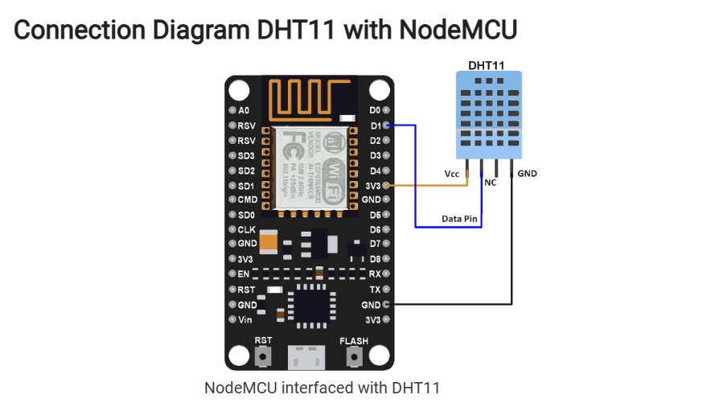
Asst. Prof. S.Asra
CSE Department, CMRIT

Slide 17
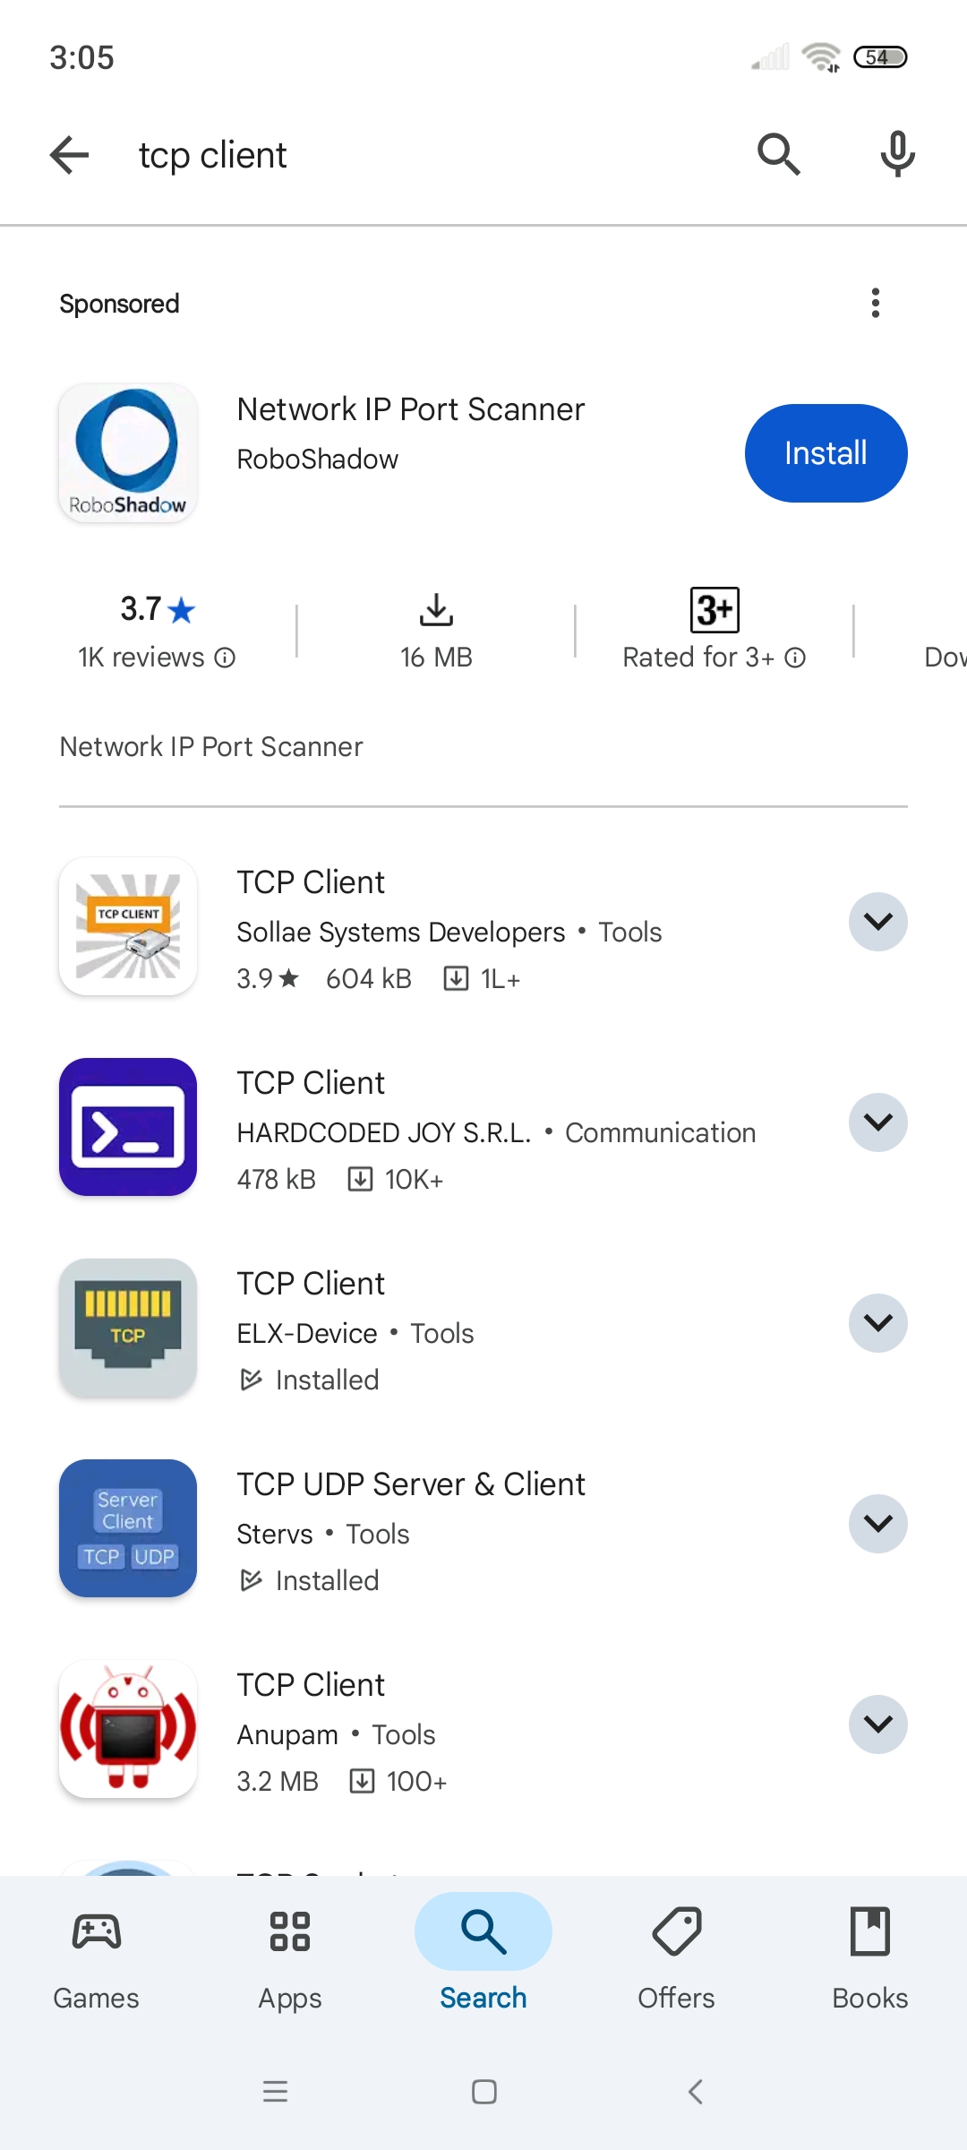
Asst. Prof. S.Asra
CSE Department, CMRIT

Slide 18
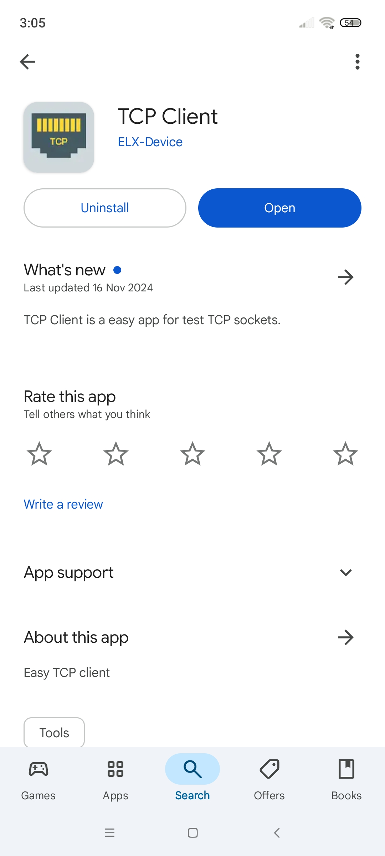
Asst. Prof. S.Asra
CSE Department, CMRIT

Slide 19
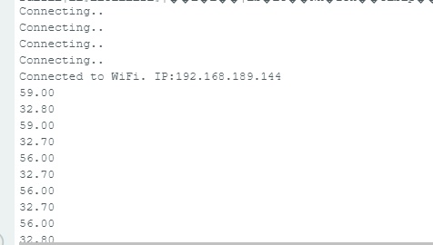
Output 1
Asst. Prof. S.Asra
CSE Department, CMRIT

Slide 20
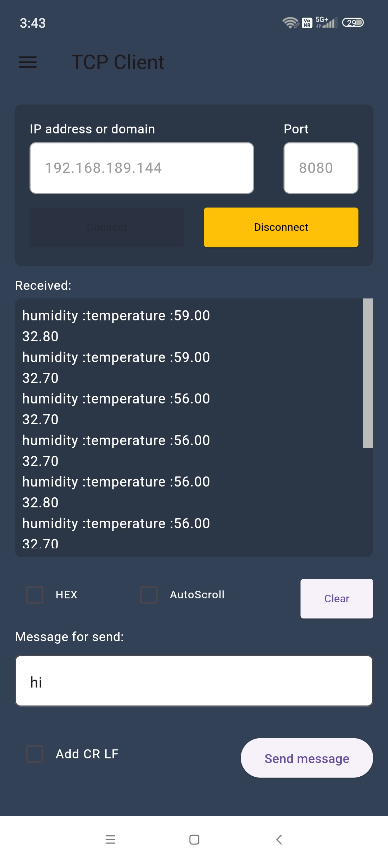
Output 2
Asst. Prof. S.Asra
CSE Department, CMRIT

Slide 21
Output 3
Asst. Prof. S.Asra
CSE Department, CMRIT

Slide 22
Output 4
Asst. Prof. S.Asra
CSE Department, CMRIT

Slide 23
THANK YOU

